Slide 1

Collaboration Inside impact through collaboration
Maarten van der Sanden, PhD.
Communication Design for Innovation
Dept. Science Education & Communication
TU Delft, The Netherlands

Slide 2
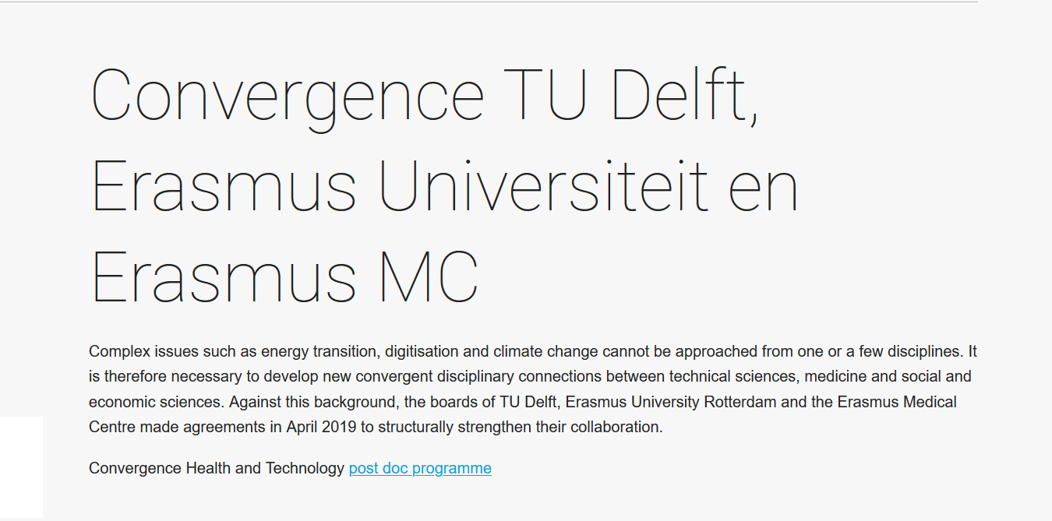
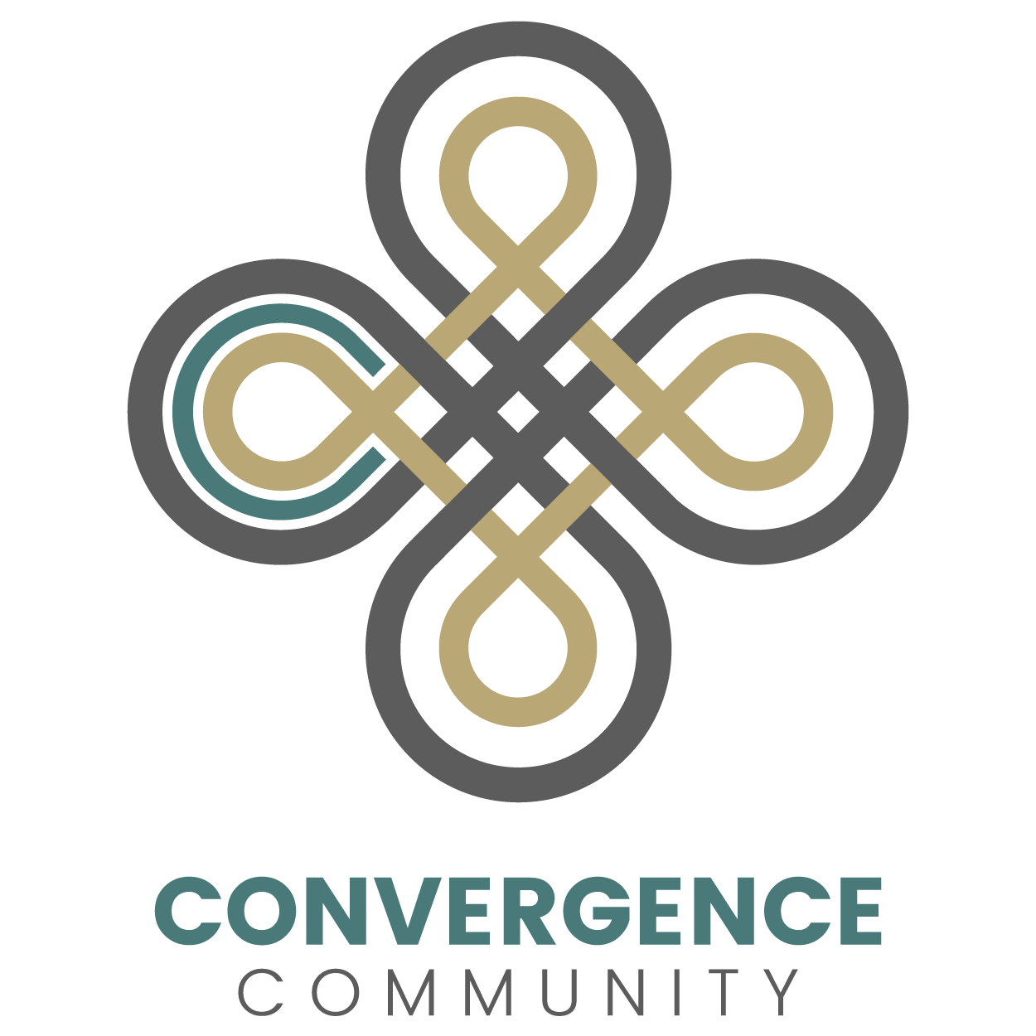
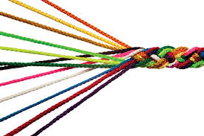

Slide 3

Future of science communication as
an impactful learning environment?

Slide 4

Who am I?
MSc, biology / science & society
Free lance science journalist
PIO / spokesman university board
PhD, social medicine / predictive DNA diag.
Communication Design for Innovation
  education
  design-based research
  community of practice

Slide 5

Berndnout Smilde, Nimbus Dumont, 2014

Slide 6
Emergent urgency to communicate: systems approach
technology
context
(Van der Sanden, Evans & Priest, 2017)
society
organisation
policy
marketing

Slide 7

human measure

Slide 8
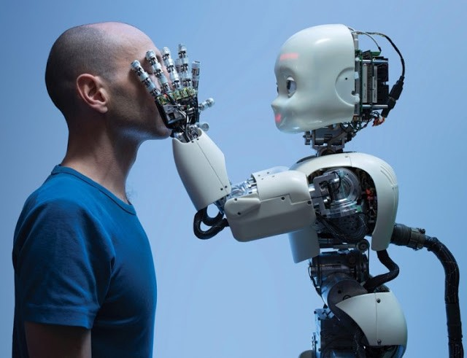
fascinated by understanding the world through transdisciplinary research & education

Slide 9


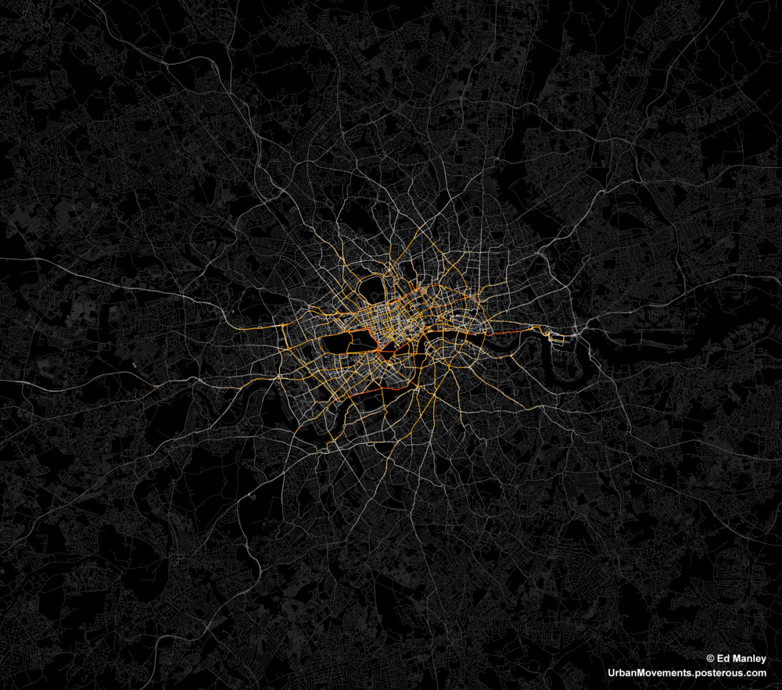
Research
decisions on interaction (HI)
and tools
detail and the whole
complex dynamic networks &
transdisciplinary learning

Slide 10
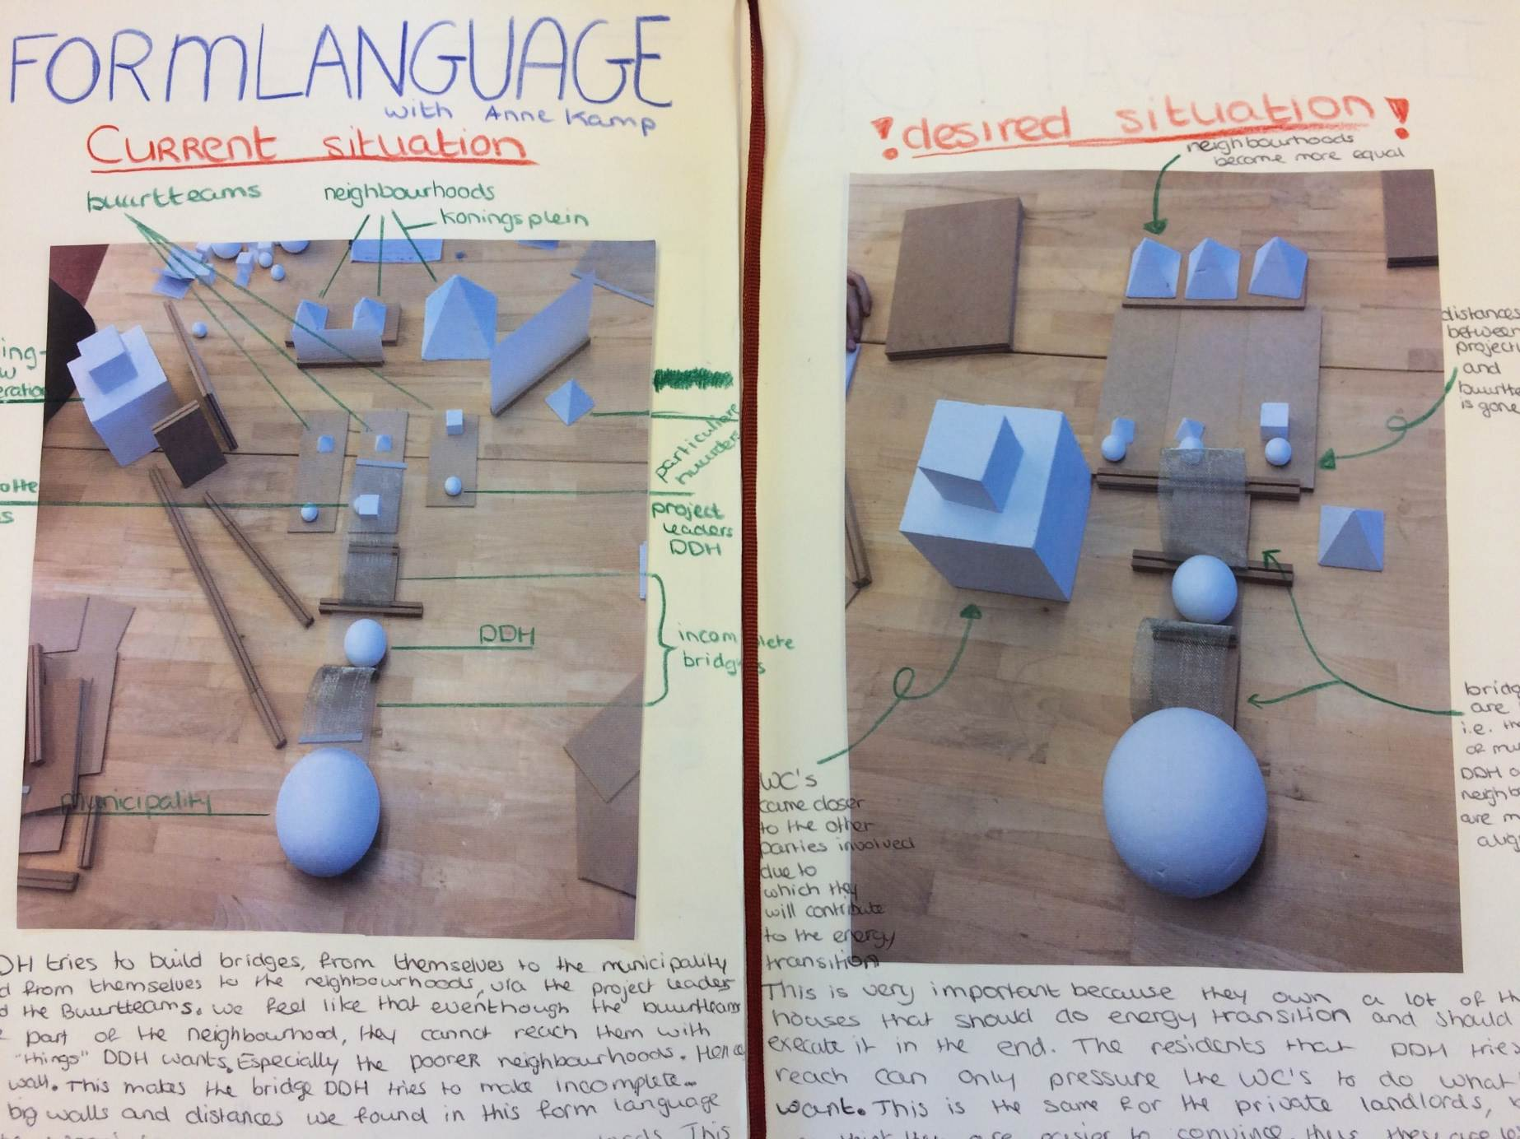
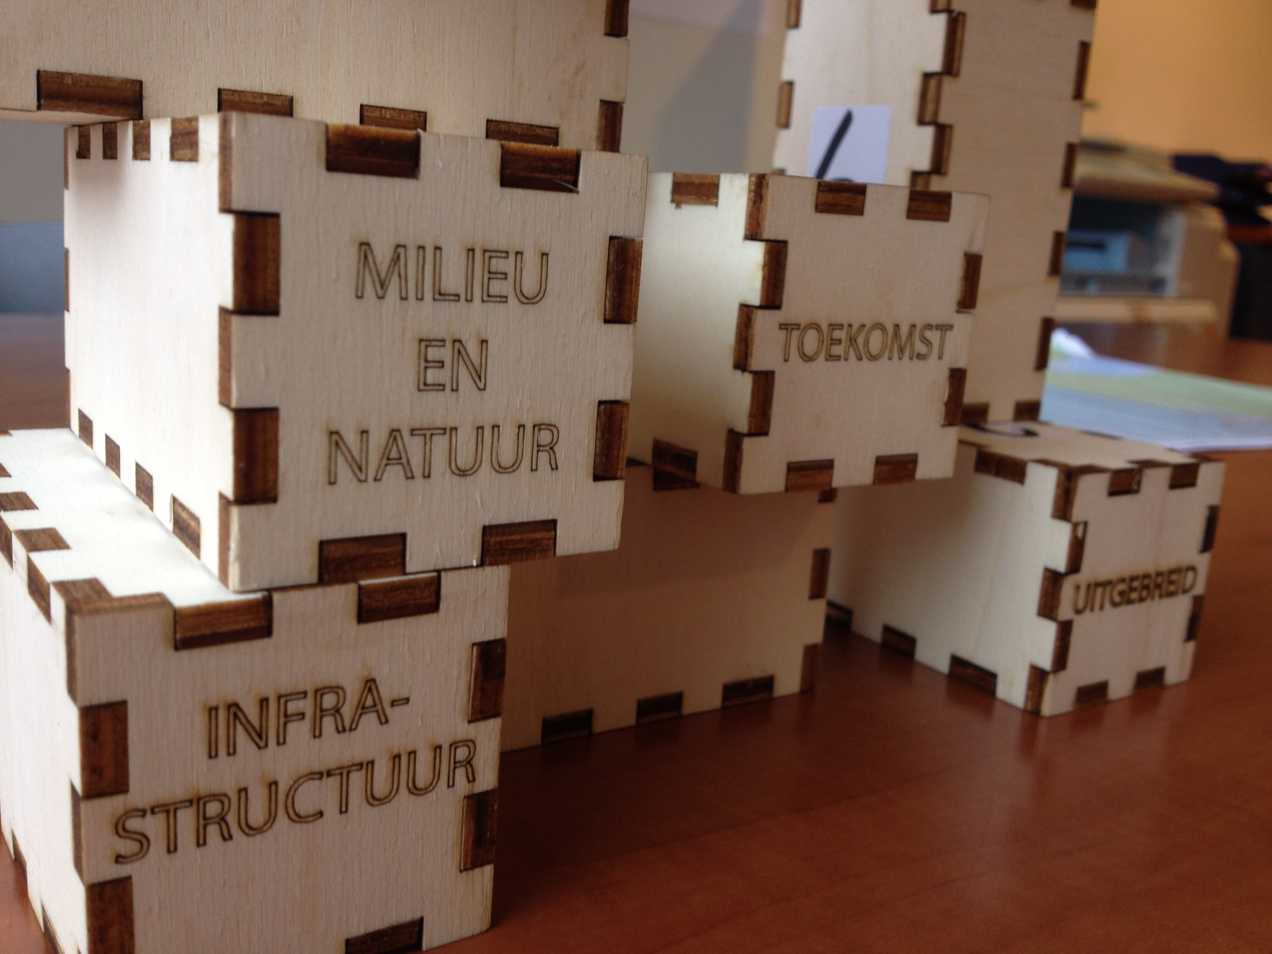
Education
10

Slide 11
Transdisciplinary communication & learning
Dept. Science
Education
& Communication
transformative
innovations
in society
transdisciplinary
co-design
for society
transdisciplinary
learning
transdisciplinary
co-design
for education
transformative
innovations
in education

Slide 12
Future of science communication
and its impact? Based on:
human measure
collaborative transdisciplinary learning

Slide 13
Share with you
Science communication is an emergent dynamic element for change in the network of science and society through which…
we learn collaboratively…
and which enables or hinders us to build bridges between people who built new futures.

Slide 14
Science Communication Ecosystem
policy & politics
(in)formal education
industry & services
citizen science
dialogue
amongst scientists
musea
media
science & technology
society
innovation
collaboration (inter&trans, public private)
(Kalmar & Stenfert, 2020; Van der Sanden & Flipse, 2015; Davies & Horst, 2016; Trench et al, 2018)

Slide 16
So…
Science communication is an emergent dynamic element for change in the network of science and society through which…
we learn collaboratively…
and which enables or hinders us to build bridges between people.

Slide 17



Variate heartbeat of interaction in convergence
innovation
idea
innovation
society
upstream
midstream
downstream

Slide 18
That entails…
Science communication is an emergent dynamic element for change in the network of science and society through which…
we learn collaboratively…
and which enables or hinders us to build bridges between people.

Slide 19
Social learning (Wenger, 2000)
engagement, alignment and imagination
“ […] whenever the two are in close tension and either starts pulling
the other, learning takes place. Learning so defined is an interplay between social competence and personal experience. It is a dynamic, two-fold relationship between people and the social learning
systems in which they participate. It combines personal transformation
with the evolution of social structures.”
Seen from a collaboration point of view, science communication (social learning) up & midstream morphs a collaborative identity and ability that may enable or hinder downstream engagement processes and vice versa !

Slide 20
Science Communication Ecosystem
policy & politics
(in)formal education
industry & services
citizen science
dialogue
amongst scientists
musea
media
science & technology
society
innovation
collaboration (inter&trans, public private)
Identity 1
Identity 2
Identity 3
upstream
midstream
downstream

Slide 21
And leads to
Science communication is an emergent dynamic element for change in the network of science and society through which…
we learn collaboratively…
and which enables or hinders us to build bridges between people.

Slide 22
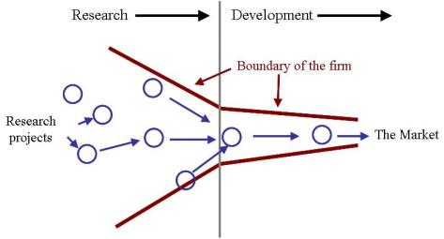
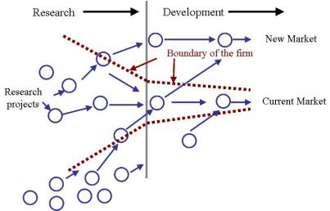
Open innovation (Chesbrough, 2006)
closed & linear
open iterative & adaptive
Identity 1
Identity 2
Identity 3
upstream
midstream
downstream

Slide 23
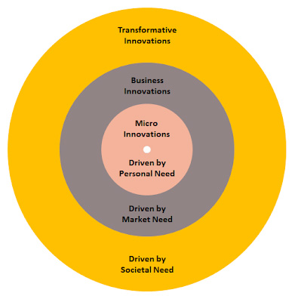
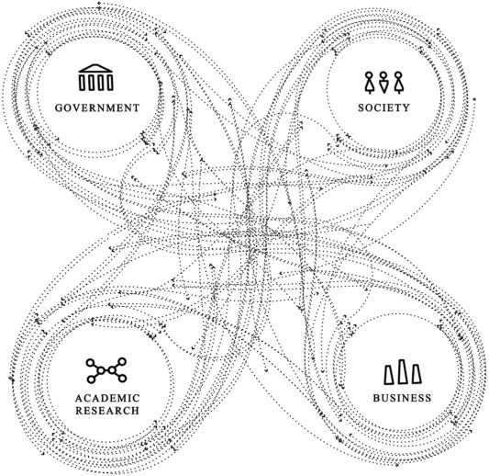
It combines personal transformation with the evolution of social structures
CDI

Slide 24
It combines personal transformation with the evolution of
social structures at all levels

Slide 25
Take aways
Science communication is an emergent dynamic element for change in the network of science and society through which…
we learn collaboratively…
and which enables or hinders us to build bridges between people…
who interact within science and technology up-, mid- and downstream at the same time…
to foster and further the complex immediate relations between science, technology & society on a human measure

Slide 26
Thanks! Suggestions? Questions?
Maarten van der Sanden, PhD.
Communication Design for Innovation
Dept. Science Education & Communication
TU Delft, The Netherlands

Slide 27
Future of science communication?
Could science communication become a trail blazer for scientific development through its collaborative power?
If yes, does that generate impact? For what or whom?
If yes, what does that take for science communication professionals? For university communicators more specific? For the education of your future colleagues?

